Slide 1
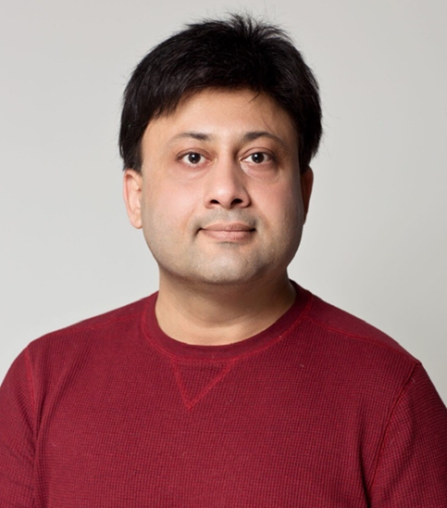
Speech and Language Relearning for Stroke Patients- Understanding User Needs for Technology Enhancement eTELEMED 2021
Awais Ahmad
Lecturer in Computer Science | e-Health Researcher | Internationalization coordinator
Department of Computer and Systems Sciences
Campus Östersund
Mid Sweden University Sweden

Slide 2
Introduction
Stroke is major causes of death and different kinds of chronic disabilities in adults, and Speech and language loss is the most common disease for stroke survivors.
The process of relearning communication skills is difficult and a time taking process. Technology-enhanced systems (TES) can be useful in speech and language relearning, however, the acceptance and usability of TES for stroke patients have been a matter of concern and more research is needed in this area.
The available software are not explicitly built for recovering stroke patients’ needs but often for children’s learning needs. This paper is, therefore, aimed at gathering requirements to support the design of speech and language relearning software applications for stroke survivors.
Notes:
This research paper focuses on speech and language disabilities and the role of TES for relearning speech and language skills. Almost one-third of a stroke survivor's ability past learning experiences, to communicate is reduced due to impaired reading, writing, listening, and speaking skills [11]-[15]. Most impairments occur during the first weeks after the stroke, but the rest of the recovery may take several years. A decreased ability to communicate has some severe consequences for the patient. One of the consequences is an unhealthy social life [16]-[20]. The patients' social life deeply affects their quality of life; they seem to lose the pure happiness of life and often they feel isolated from society [21]-[25]. To reduce the potential risk for a patient’s depressed mental state, the process of relearning communication skills needs to be started as soon as possible after a stroke. Several studies highlighted the benefits of early interventions right after the stroke [26]-[30].

Slide 3
Speech and language impairments The basic reason for stroke is a partial or complete stoppage of blood flow to the brain that severely infects the brain function, consequently, the overall human body may face different types of disabilities. Speech and language deficiencies are major part here [1].
[1] https://newsnetwork.mayoclinic.org/discussion/mayo-clinic-q-and-a-speech-therapy-after-a-stroke/

Slide 4
Aim
The study aimed to gather the requirements for designing an interactive speech relearning software application for stroke survivors. The requirements were also considered from the adult learning principles' perspective.
The addressed research questions :
1. What are the requirements for designing an interactive software application for speech relearning exercises following a stroke?
2. How can the principles of adult learning support understanding the patients' needs?

Slide 5
Knowles’ Adult learning theory
The adult learning theory (andragogy) highlights that adults tend to learn differently than traditional children's education that is usually referred to as pedagogy (Knowles et al., 2014).
Knowles suggested that adults should actively participate in the planning, development, and implementation of the learning process (Knowles et al., 2014).
Stroke is most common in adults, however, commonly used speech relearning applications are not developed from an adult’s learning perspective. Therefore, adult learning principles should be involved in the requirement identification process.

Slide 6
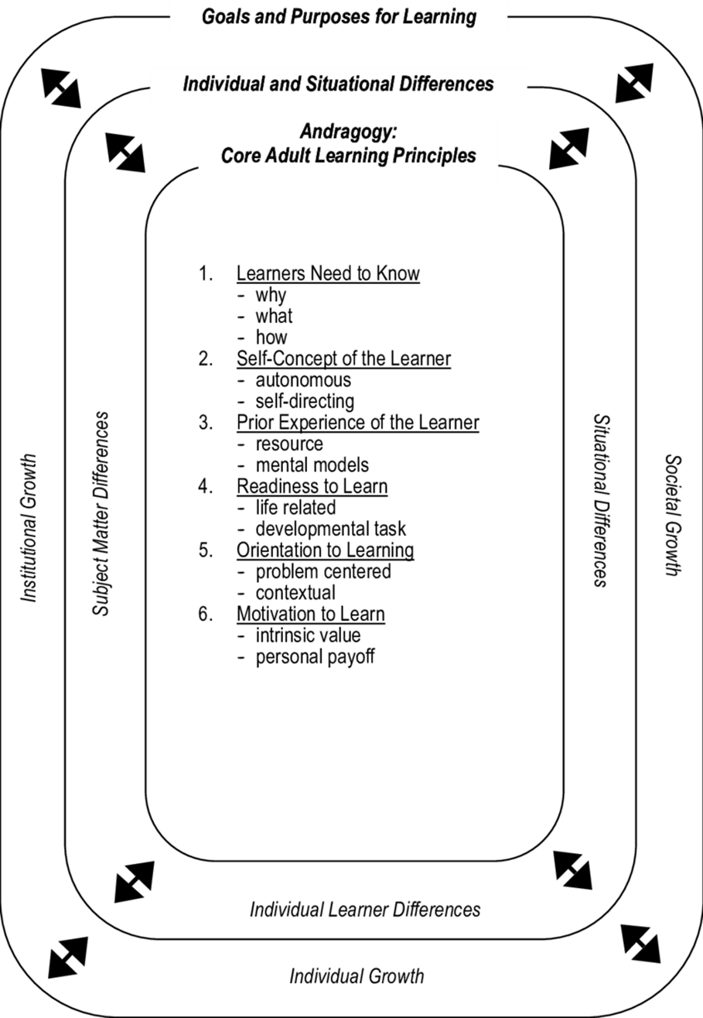
Andragogy in practice Model
Source: Knowles et al. (2014). The adult learner: The definitive classic in adult education and human resource development, page 80. Routledge
Notes:
Based on the adult learning principles as described in the previous silde, Knowles suggested a conceptual framework that can be adopted for several adult learning practice.
As shown in the figure, the three dimensions of adult learning in practice may influence the adult learning process.
The outer ring presents goals and purposes for learning that can be seen as developmental outcomes for the learner.
The goals can be categorized into individual, social and institutional growth of the learner.
The middle ring shows individual and situational differences that might have an impact on learning practices. These differences are further categorized as individual learner differences, subject matter differences, and situational differences.

Slide 7
Research Methodology: Design Science

Slide 8
Study Participants
Participants | Professional role | Years of experience
Participant 1 | Speech therapist #1, Östersunds Rehabcentrum | 25
Participant 2 | Speech therapist #2, Östersunds Rehabcentrum | 4
Participant 3 | Speech therapist #3, Stockholm Rehabcentrum | 5
Participant 4 | Stroke specialist doctor and manger in the regional hospital | 25
Participant 5 | Occupational Therapist, Mobile Stroke Team, Regional hospital | 5
Participant 6 | Physiotherapist #1, Mobile Stroke Team, Regional hospital | 8
Participant 7 | Physiotherapist #2, Mobile Stroke Team, Regional hospital | 3
Participant 8 | Chairman of the local stroke patient organization | 3
Participant 9 | CEO of a small company working with game-based stroke rehabilitation | 25
Participant 10 | Hardware and software specialist at Microsoft | 9
Participant 11 | Head of Mobile Stroke Team, Regional hospital | 15

Slide 9
Study Findings The patient’s need to know
Involvement of patients from the start while discussing re-learning
Importance of describing the actual situation of patient
Motivation is important while discussing what can be achieved.
For a person involved in managing various situations, such as being a politician or chairman, is speech of specific interest to continue activities conducted before the stroke as much as possible.
Therefore, the patients need to know what they can do to live their lives as much as possible as before the stroke.
Notes:
The findings were analyzed thematically according to the Knowles Andragogy in Practice Model (APM); as shown in Figure 1. The patients' needs for technology enhancement are presented using adult learning principles as core themes. The adult learning theory and its principles were described to the speech therapist in regional rehabilitation (Participants 2). Supersizing, they have been considering speech and language from the adult learning aspects without knowing those principles, and they endorsed the idea of involving these principles for technology-enhanced speech and language relearning.

Slide 10
Study Findings Establishing learning objectives
Learning objectives should be defined after an assessment of patient’s physical and cognitive condition.
The assessment relies on an analogue procedure, developed and used in Sweden by speech therapists, and is commonly used throughout the country. Both speech therapists are keen on converting the analogue assessment process into an interactive speech and language assessment application, where the results would easily be stored and used as input for the re-learning assignments.
Notes:
The assessment is conducted as a standardized procedure, involving sets of detailed assignments. Before starting the standardized procedure, the speech therapists decide which parts to assess, based on the patient’s described injuries. The assessment relies on an analogue procedure, developed and used in Sweden by speech therapists, and is commonly used throughout the country. Both speech therapists are keen on converting the analogue assessment process into a digital one, where the results would easily be stored and used as input for the re-learning assignments.

Slide 11
Study Findings Readiness to learn
After designing the learning strategy and tools, the patients should be prepared for the implementation of the learning strategy. Proper education and training, usability considerations, and social aspects of TES might increase the readiness to learn for patients. Almost all the participants emphasized the importance of technology acceptance requirements such as usefulness, ease of use, adaptability, and satisfaction of the application
Notes:
After designing the learning strategy and tools, the patients should be prepared for the implementation of the learning strategy. Proper education and training, usability considerations, and social aspects of TES might increase the readiness to learn for patients. Almost all the participants emphasized the importance of technology acceptance requirements such as usefulness, ease of use, adaptability, and satisfaction of the software application (Participants 1-8, 11). Two of the speech therapists informed us that there are some applications available for speech relearning exercises; however, they have not developed specificity according to stroke patient's medical conditions (Participant 1, 2). The tendency to use those applications heavily depends on the degree of impairments after stroke and the overall patient's health (Participant 5-7).
Two speech therapists suggested different levels of login settings for patients and medical caregivers. The software should have a simpler version of the interface for the patients where they can perform their exercises; however, the speech therapists should have a detailed version where they can administer, and suggest and monitor different kinds of speech therapies (Participant 2, 3). The stroke specialist doctor highlighted that the patient should feel a sense of pleasure and satisfaction while using software applications; therefore, goal-oriented training with the element of entertainment can improve the usability of this software (Participant 4). One suggestion, from the chairman of the local stroke organization, is the involvement of music and dance during the relearning exercises (Participant 8).

Slide 12
Study Findings
The intensity of relearning exercises: Less intensive exercises showed more improvement than highly intensive exercises.
Possibility of social networking: A feature in the software application that provides the involvement of friends and family.
Native language: The software application should be in the Swedish language.
Patient’s Medical condition VS selection of relearning exercises

Slide 13
Study Findings
Involvement of medical caregivers and stroke patients in the design process
Technical assistance and training: Not only the application should be interactive and easy to use by itself, the process of training and education of using the application should also be interactive, user-centered, and in the native language.
Medical assistance and education: A proper education and assistance about stroke rehabilitation is essential for the patients and their close relatives.

Slide 14
Study Findings
Selection of hardware: A larger screen size than a smartphone like a tablet or desktop computer will be more appropriate for patients with aphasia spatially for older adults.
Graphical interface: The interface should be adjusted according to stroke patients' needs. For example, typography size should be bigger than usual and the background should be simple to avoid distraction. Ideally, the font size should be adjustable and the background themes should be changeable. Moreover, the colors should be more contrastive between selected and unselected items on the screen.

Slide 15
Conclusion
Despite their impaired medical condition, stroke patients tend to use TES for speech and language relearning.
The study findings indicate that independent living, treatment in the home environment, and improved quality of life are the major motivational factors for the use of TES.
The usability factors of software and hardware such as customized graphical user interface and bigger size of hardware screen are vital for the acceptance of TES.
Proper education of technical and medical aspects of the software are also important for higher user acceptance.

Slide 16
Future Work
This study found essential requirements for the future development of technology-enhanced applications for speech and language relearning tailored for stroke patients. The next planned steps are to design, develop, and evaluate technology-enhanced application to support the diagnosis and the relearning process after stroke. Both these applications should be designed and tested with a multi-stakeholder approach involving caregivers, software developers, stroke patients, and stroke patients' friends and family. To carry out the work with a multi-stakeholder approach is essential since a stroke patient's speech relearning journey back to an independent life is a long and tedious one.

Slide 17
Speech and Language Assessments Application
Step 1: Patient’s information

Slide 18
Speech and language Assessments Application
Step 2: Patient’s speech and language impairment diagnosis

Slide 19
Speech and language Assessments Application
Step 3: Patient’s speech and language impairment evaluation

Slide 20
Speech and language assessments Application- Patients’ Interface

Slide 21
THANK YOU Email: awais.Ahmad@miun.se
Awais Ahmad
Lecturer in Computer Science | e-Health Researcher | Internationalization coordinator
Department of Computer and Systems Sciences
Campus Östersund
Mid Sweden University Sweden

