Slide 1

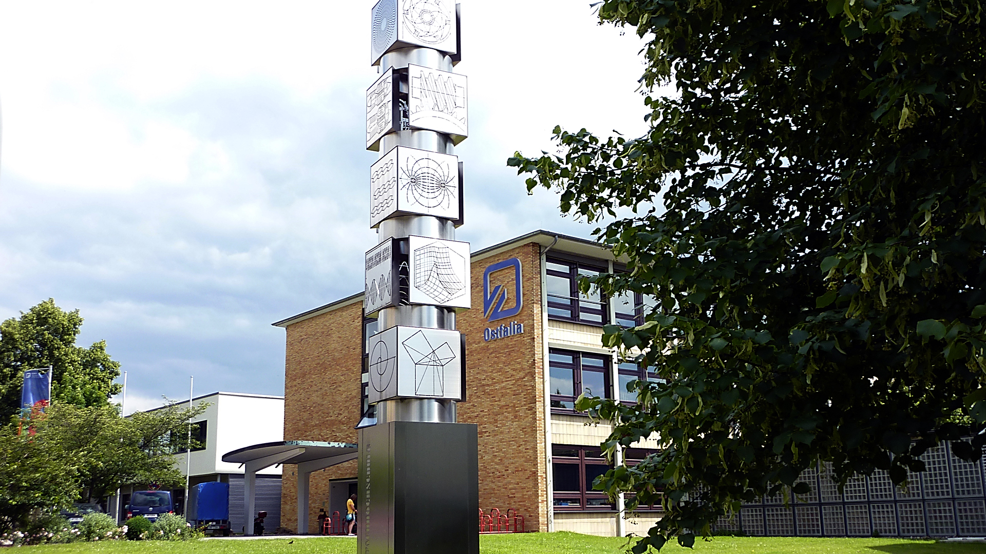
Decentralized Cooperative Intersection Management Based on Connected Autonomous Vehicles for Urban Unsignalized Intersections
International Academy, Research, and Industry Association
24.-28. April
ICONS 2023
jie.zhang@ostfalia.de
Jie Zhang | Marian Göllner| Xiaobo Liu-Henke

Slide 2
Model-based design of vehicle mechatronic systems
Development of the virtual test bench for modelling and simulation of the cyber-physical production systems with integrated Industry 4.0 solutions
Networking of smart home, smart traffic, and smart grid to stabilize the energy grid and increase energy efficiency
Development of cooperative driving functions to realize autonomous driving for AGVs in intralogistics and for vehicles in public road traffic

Slide 3
Agenda
Introduction and motivation
State of the art
Methodology
Development of the decentralized cooperative intersection management
Function validation via MiL-Simulations
Conclusion

Slide 4
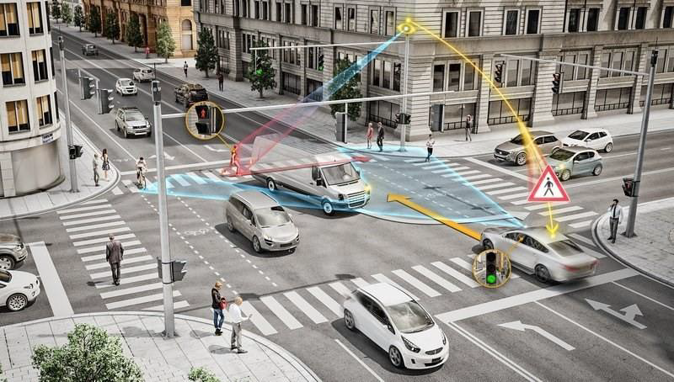
State of the art
Community Database of the European Union “CARE”: 20% of traffic fatalities are attributable to road traffic at intersections
In USA: 40% of accidents and 21.5% of traffic fatalities occur at intersections
In Germany: about two-thirds of all cyclist accidents with personal injury recorded by the police in urban areas occurred at intersections
intersection management
optimize traffic throughput
ensure proactive safety
Source: https://www.next-mobility.de/wie-intelligente-kreuzungen-smart-cities-sicherer-machen-a-672908/

Slide 5
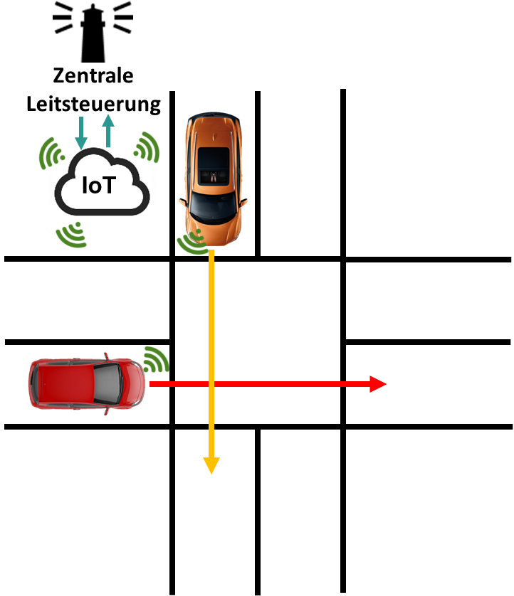

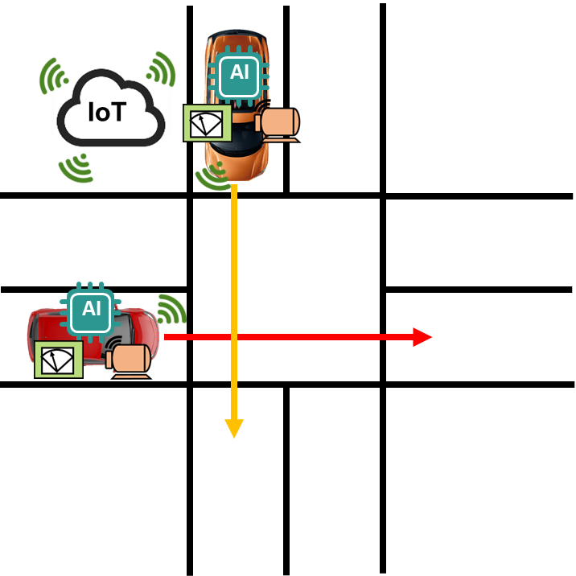
Cooperative intersection management
Introduction and motivation
based on networked autonomous vehicles
creating and executing a (global) optimal sequence for road users
Central control system for dispatching the passing vehicles and determining their speed and sequence
commands from higher hierarchical level to automated vehicles through V2I
Global optimization of traffic flow
Decentralized negotiation between vehicles to coordinate speed and sequence through V2V
No commands from higher hierarchical level
Suboptimal solution
Central cooperative intersection management
Decentralized cooperative intersection management

Slide 6
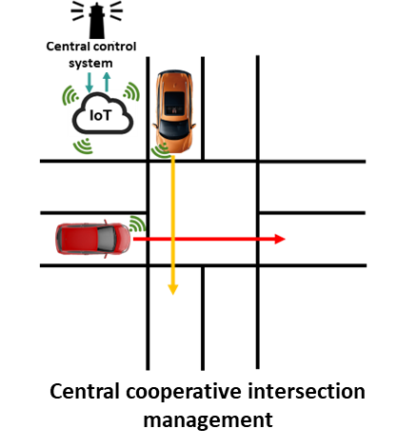
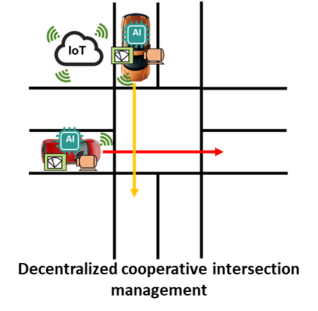
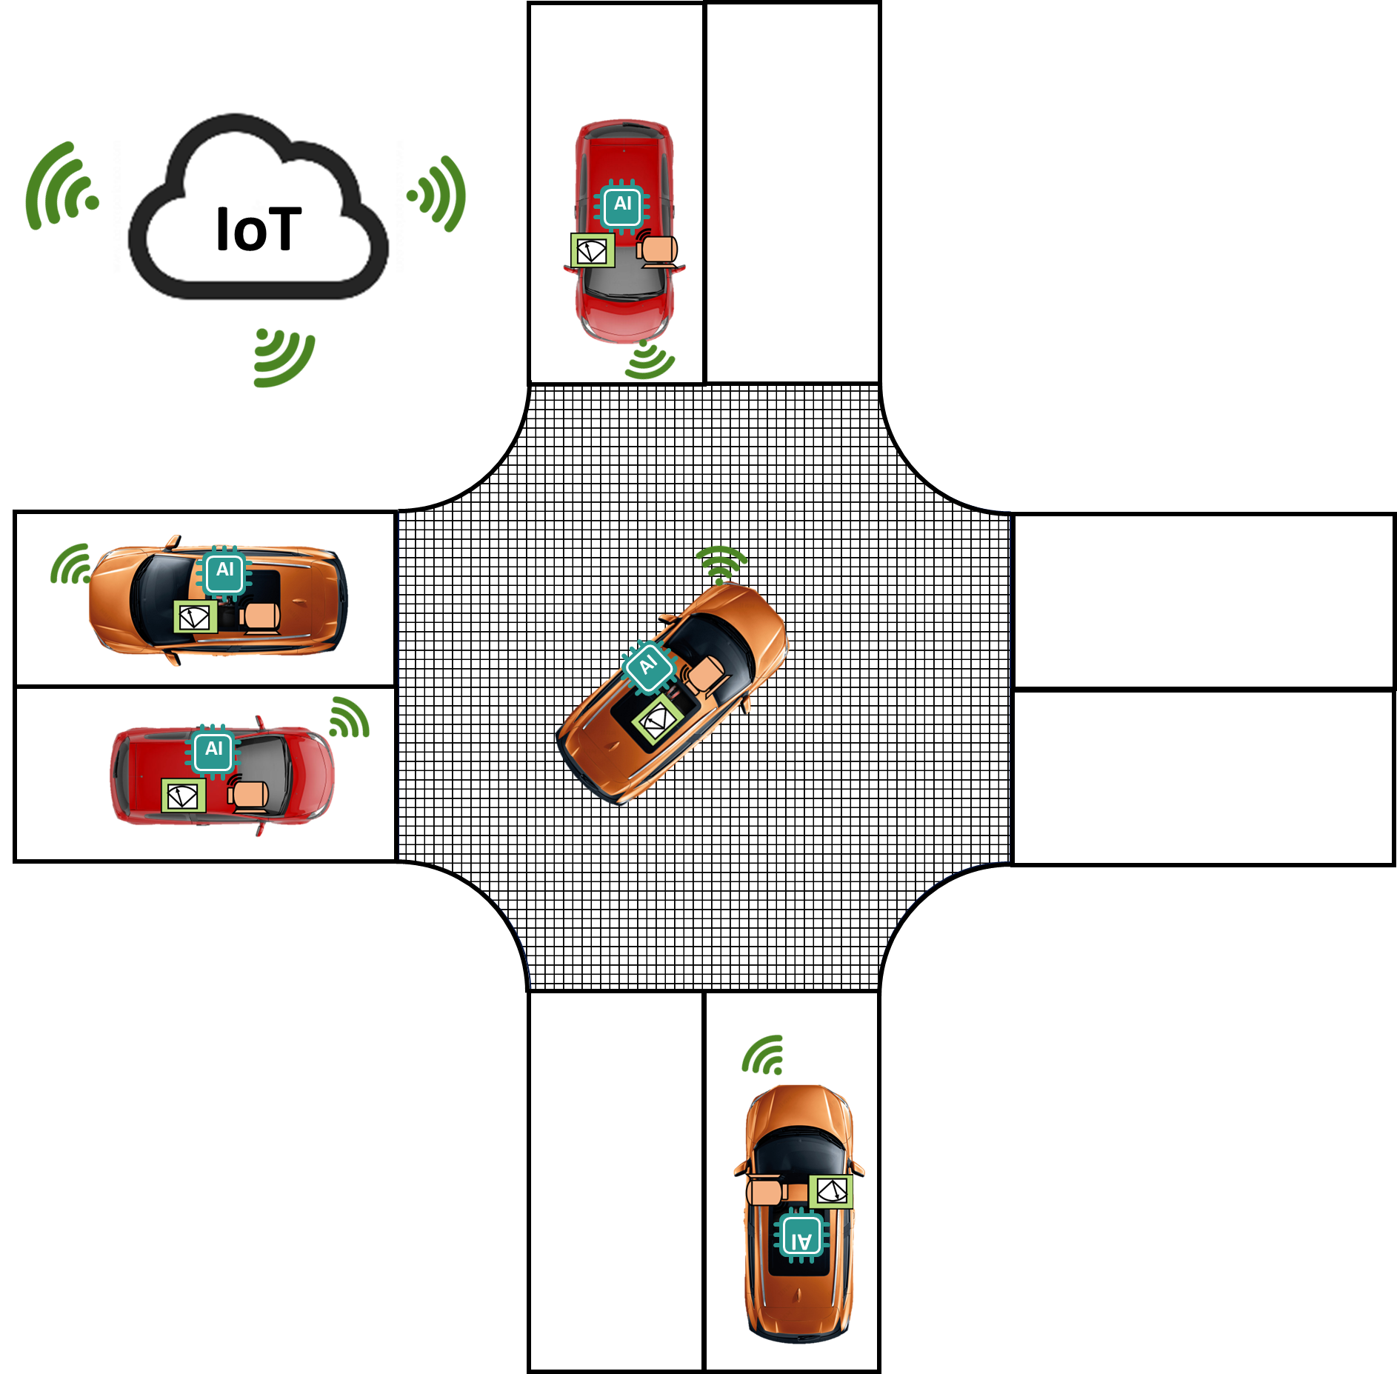
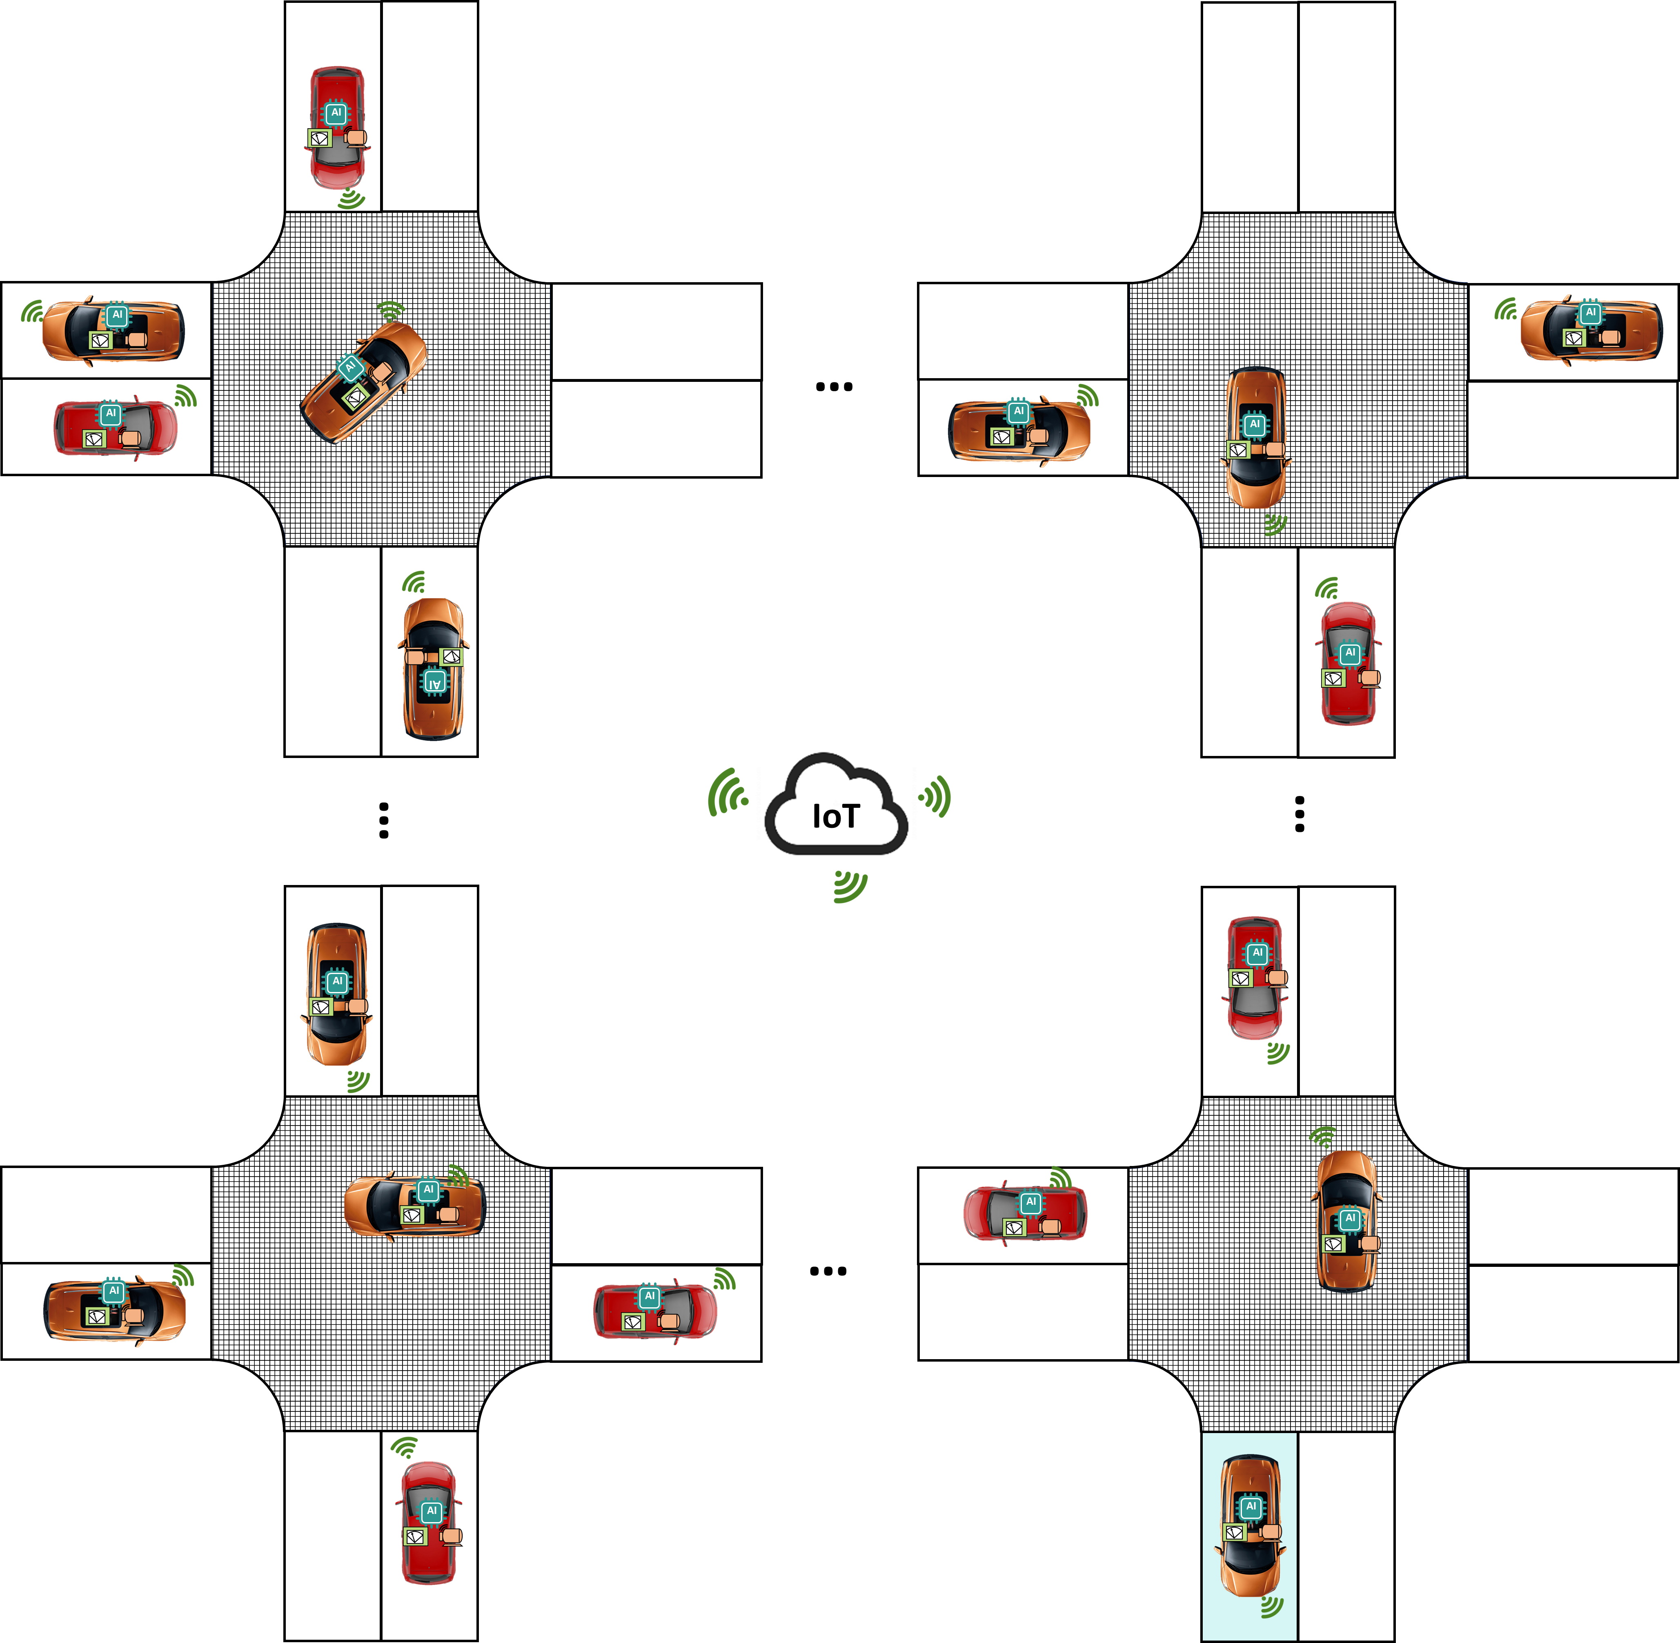
Cooperative intersection management
Introduction and motivation
based on networked autonomous vehicles
creating and executing a (global) optimal sequence for road users
Deficits of the current research:
Focus on the isolated single intersection
vehicle's behaviors at the single intersection are interdependent
the causality loops in the trajectory planning of the vehicles
resulting in no reasonable solution
developed under certain constraints and for specific application scenarios
area-wide cooperative intersection management
network-wide cooperative intersection management

Slide 7
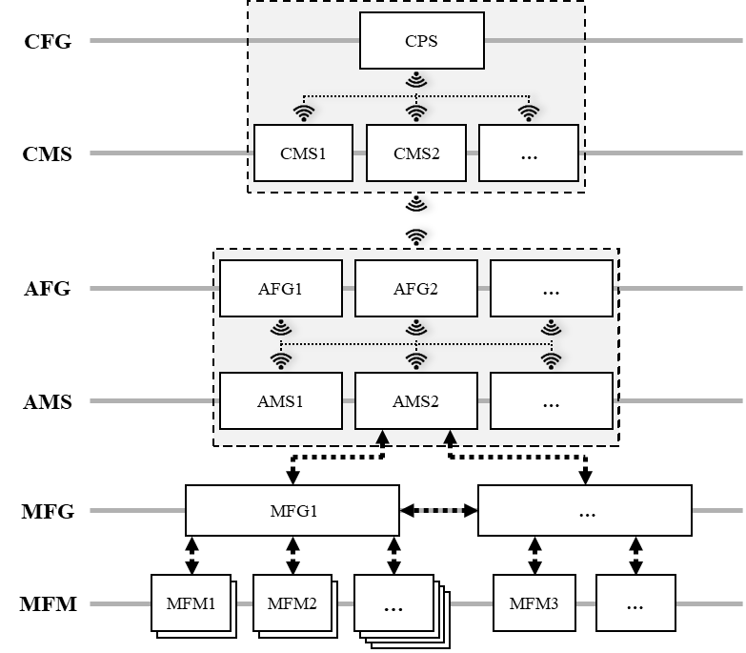
Mechatronic structuring
Methodology
Cross-linked Function Group (CFG)
Autonomous Function Group (AFG)
Cross-linked Mechatronic System (CMS)
Autonomous Mechatronic System (AMS)
Mechatronic Function Group (MFG)
Mechatronic Function Module (MFM)

Slide 8
Development of the decentralized cooperative intersection management
Definition of the general requirements:
Optimization traffic throughput and guarantee proactive safety
The universality of the intersection management
The real-time capability and reliability of the intersection management
Derivation the specific requirements
The potential conflicts must be identified early and avoided.
The technical constraints regarding the dynamic and kinetic driving behaviors and legal limitations must be observed.
The data structure of the information must be uniform.
…

Slide 9
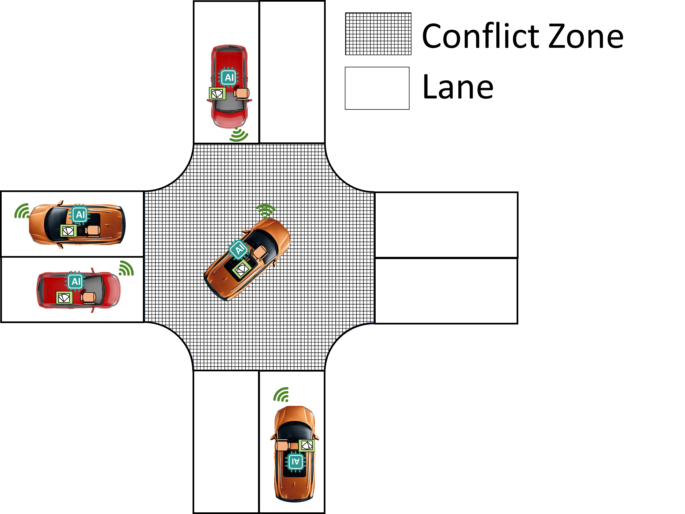
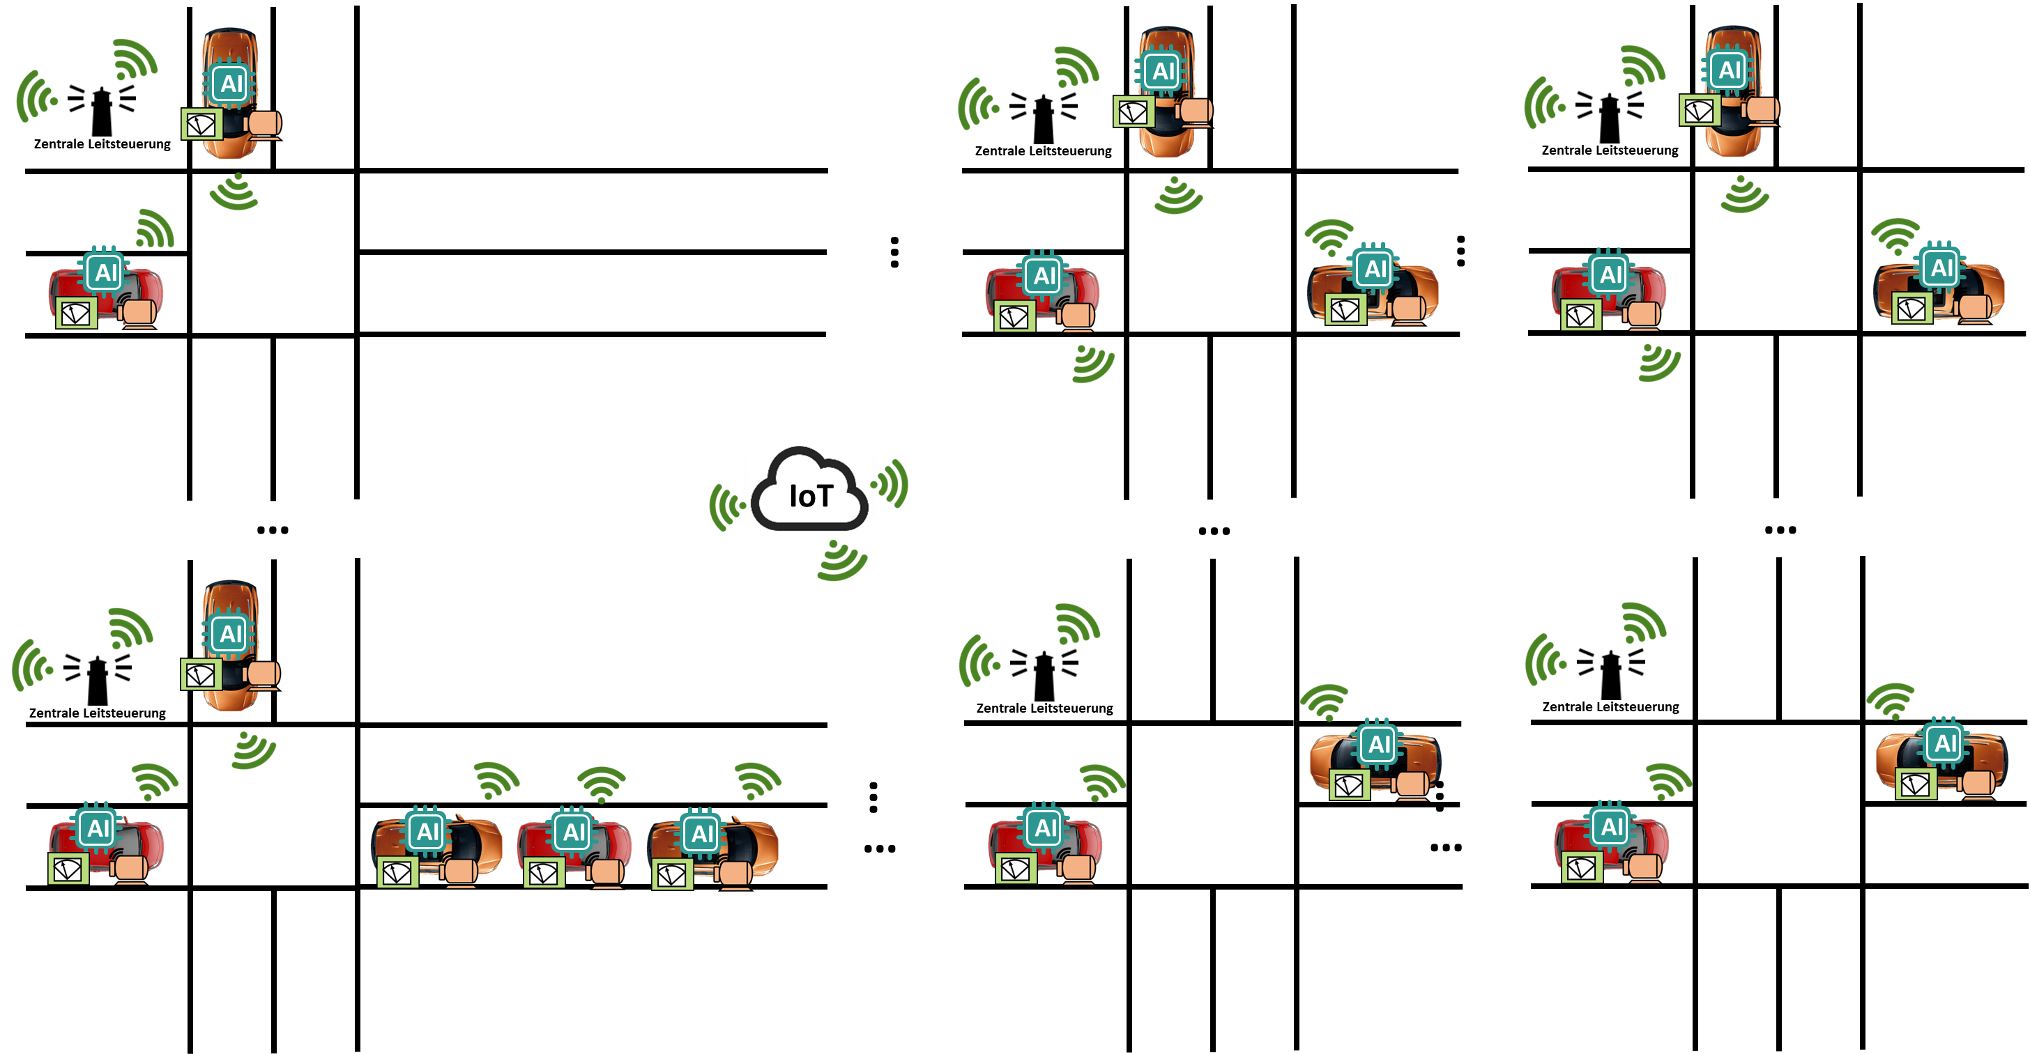
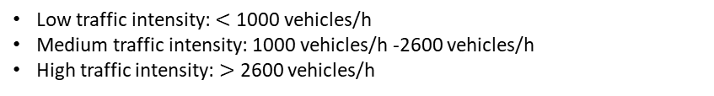
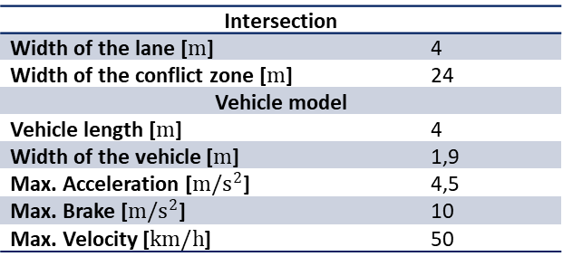
Simulation scenario
Function validation via MiL-Simulations
Test case 1: Single intersection with regular traffic volume in all entry directions
Low traffic intensity: $<$ 1000 vehicles/h
Medium traffic intensity: 1000 vehicles/h -2600 vehicles/h
High traffic intensity: $>$ 2600 vehicles/h
Test case 2: Single intersection with irregular traffic volume in entry directions
Traffic intensity in east-west direction = a* Traffic intensity in north-south direction
Test case 3: Road network with four intersections
Intersection
Width of the lane [$m$] | 4
Width of the conflict zone [$m$] | 24
Vehicle model
Vehicle length [$m$] | 4
Width of the vehicle [$m$] | 1,9
Max. Acceleration [$m/s^{2}$] | 4,5
Max. Brake [$m/s^{2}$] | 10
Max. Velocity [$km/h$] | 50

Slide 10
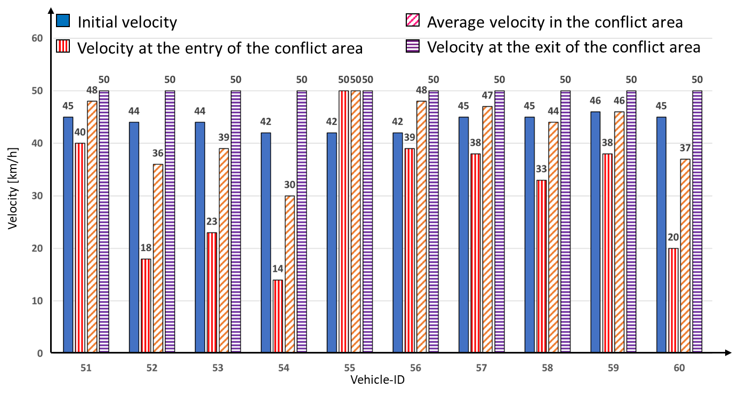









Analysis of the simulation results
Function validation via MiL-Simulations
Test case 1: Single intersection with regular traffic volume in all entry directions
Speed of vehicles crossing the intersection
$$v_{init}$$
$${\overline{v}}_{k}$$
$$v_{i_k}$$
$$v_{o_k}$$
$$v_{i_k}$$
$$v_{init}$$
$$v_{o_k}$$
$${\overline{v}}_{k}$$

Slide 11

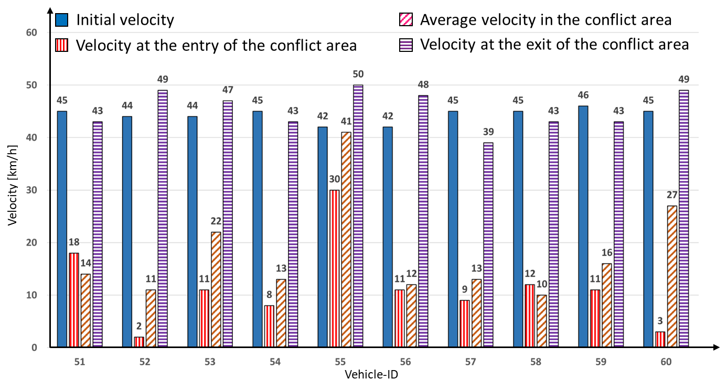
Analysis of the simulation results
Function validation via MiL-Simulations
Test case 1: Single intersection with regular traffic volume in all entry directions
Speed of vehicles crossing the intersection with traffic volume of 3600 vehicles/h.
Speed of vehicles crossing the intersection with traffic volume of 7200 vehicles/h.

Slide 12
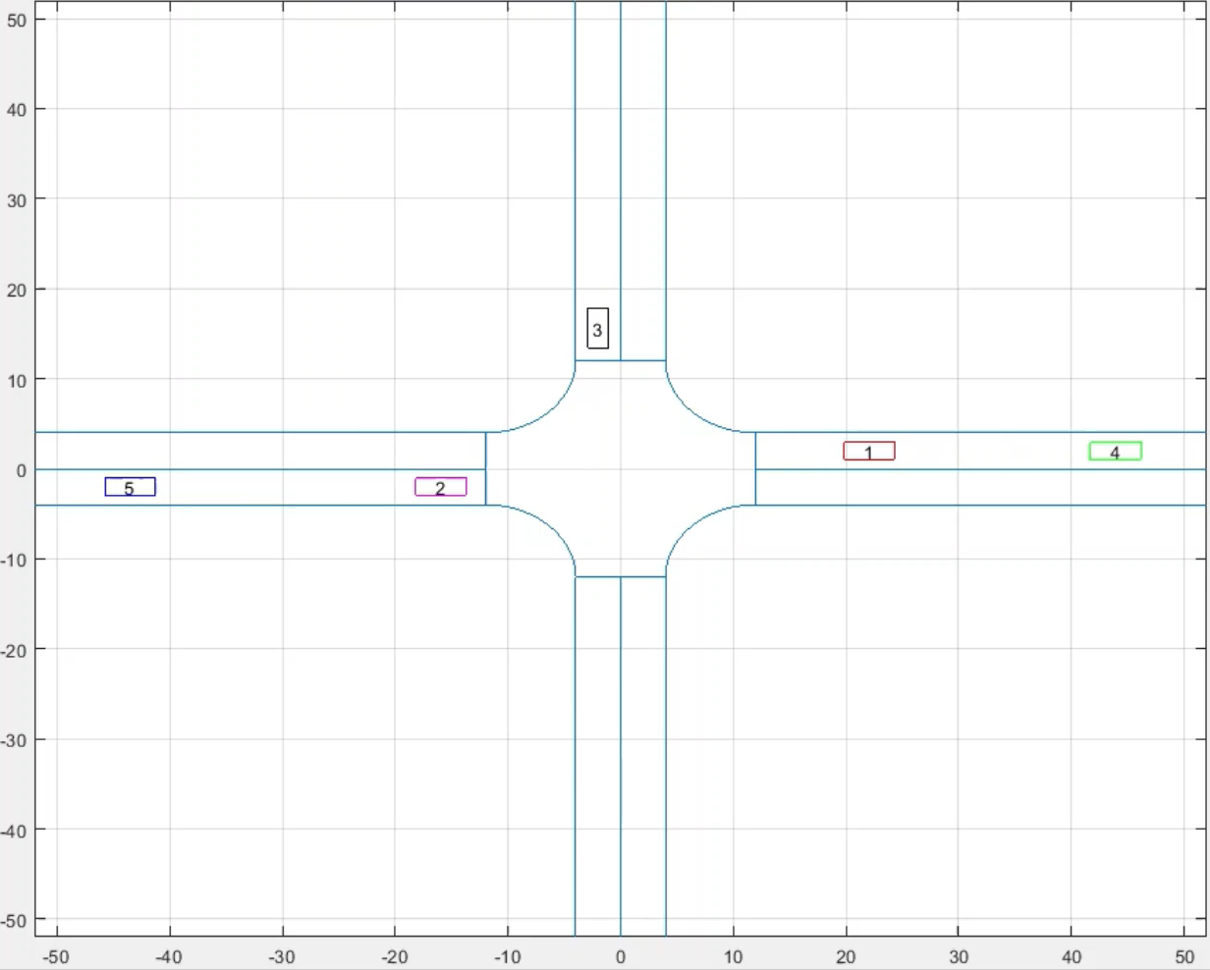
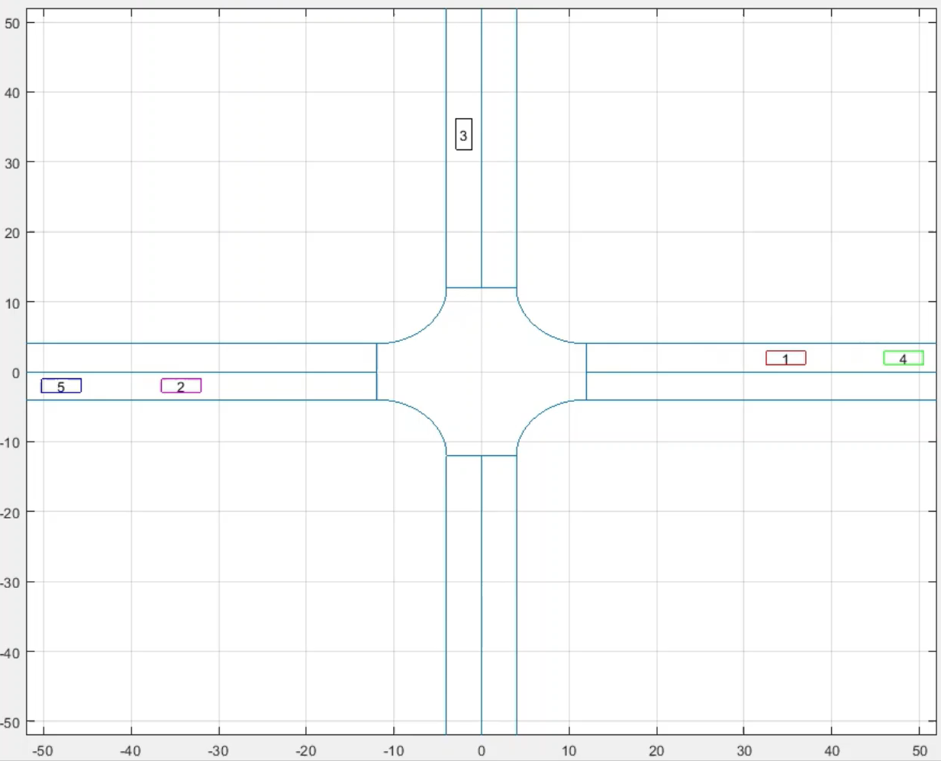
Analysis of the simulation results
Function validation via MiL-Simulations
Test case 1: Single intersection with regular traffic volume in all entry directions
Traffic Intensity:
3600 vehicles/h
Traffic Intensity:
7200 vehicles/h

Slide 13
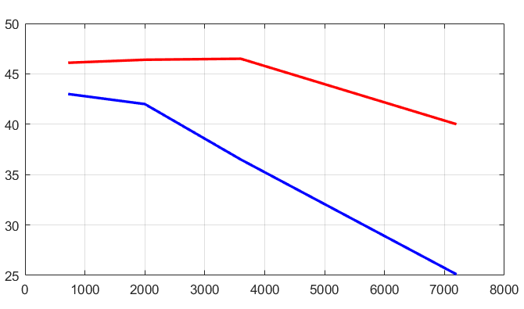
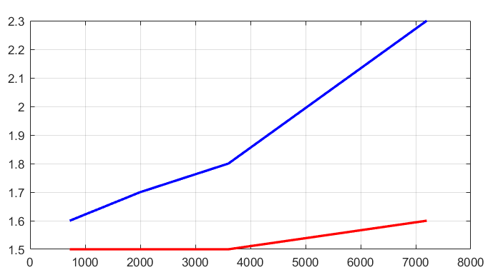


Analysis of the simulation results
Function validation via MiL-Simulations
Test case 2: Single intersection with irregular traffic volume in entry directions
Traffic intensity in east-west direction = 2* Traffic intensity in north-south direction
Regular Traffic Intensity
Irregular Traffic Intensity
Zeit $t_{k}$ [s]
Velocity $v_{i_k}$ [km/h]
Regular Traffic Intensity
Irregular Traffic Intensity
Traffic Intensity [vehicles/h]
Traffic Intensity [vehicles/h]
Notes:
By system initialization, the vehicle speed is generated randomly

Slide 14
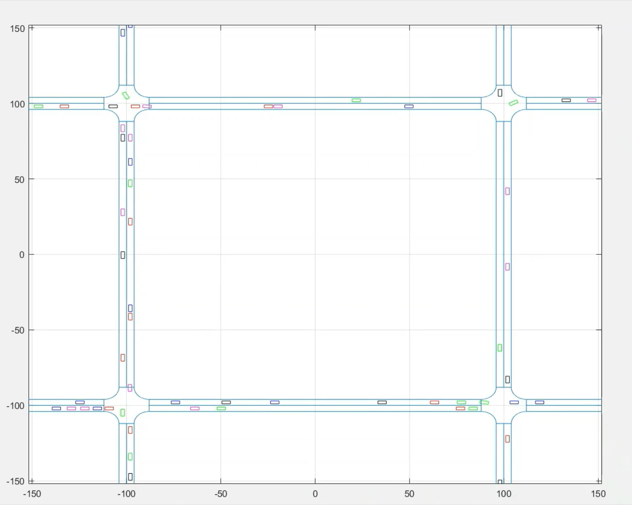
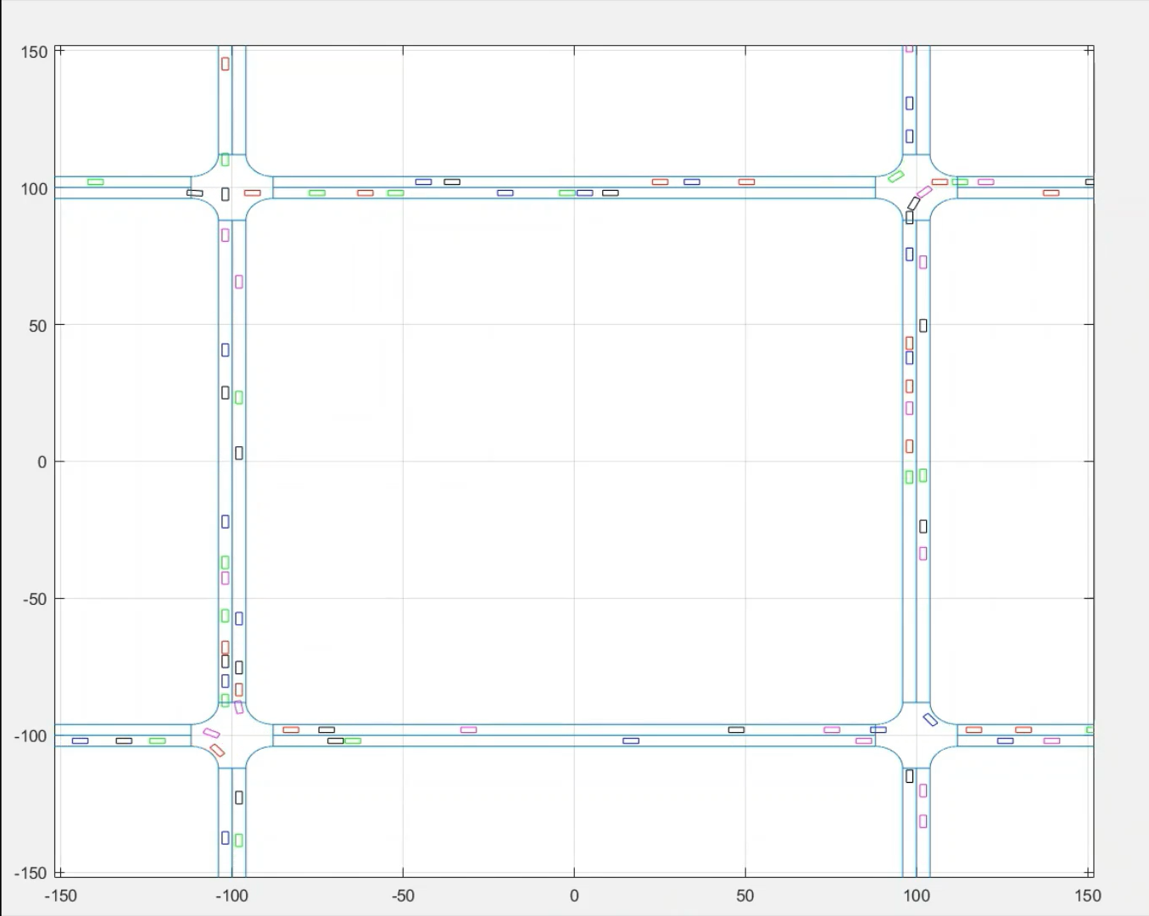
Analysis of the simulation results
Function validation via MiL-Simulations
Test case 3: Road network with four intersections
Traffic intensity: 7200 vehicles/h
Traffic intensity: 14400 vehicles/h

Slide 15
Conclusion
Development of the decentralized cooperative intersection management system
Creation of the system and functional structure of the CPS based on the requirements
Validation of the functionality through Simulation in virtual test bench with different traffic intensity
Application in intersections with different topological characteristics
Evaluation of the performance of centralized and decentralized intersection management

Slide 16
Decentralized Cooperative Intersection Management Based on Connected Autonomous Vehicles for Urban Unsignalized Intersections
International Academy, Research, and Industry Association
24.-28. April
ICONS 2023
jie.zhang@ostfalia.de
Jie Zhang | Marian Göllner| Xiaobo Liu-Henke

Slide 17
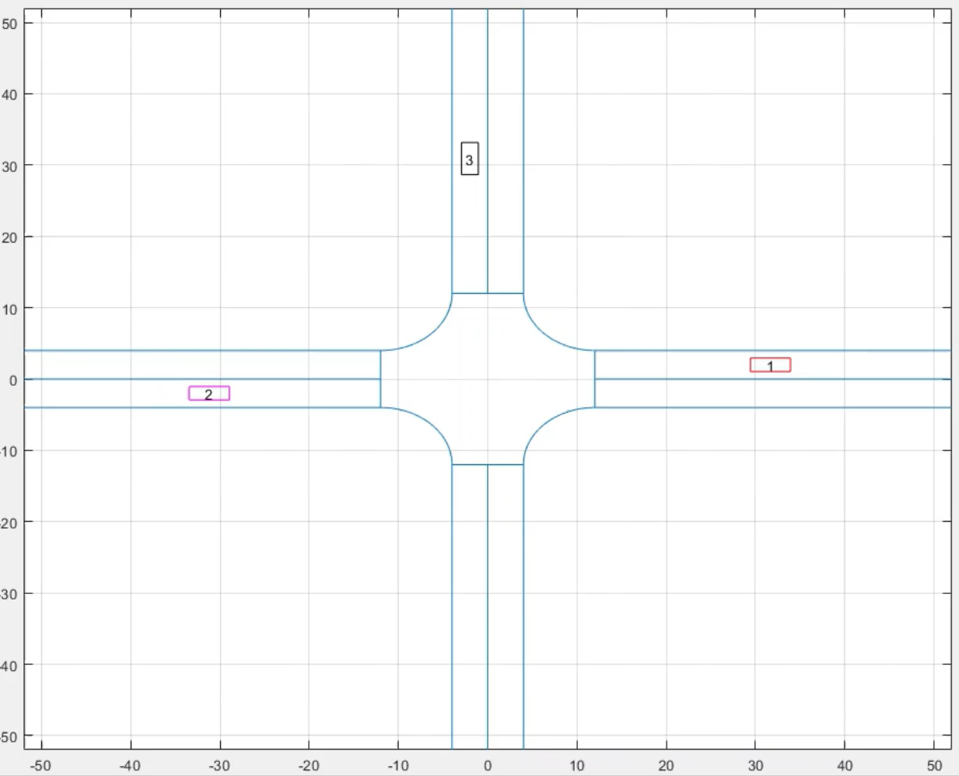
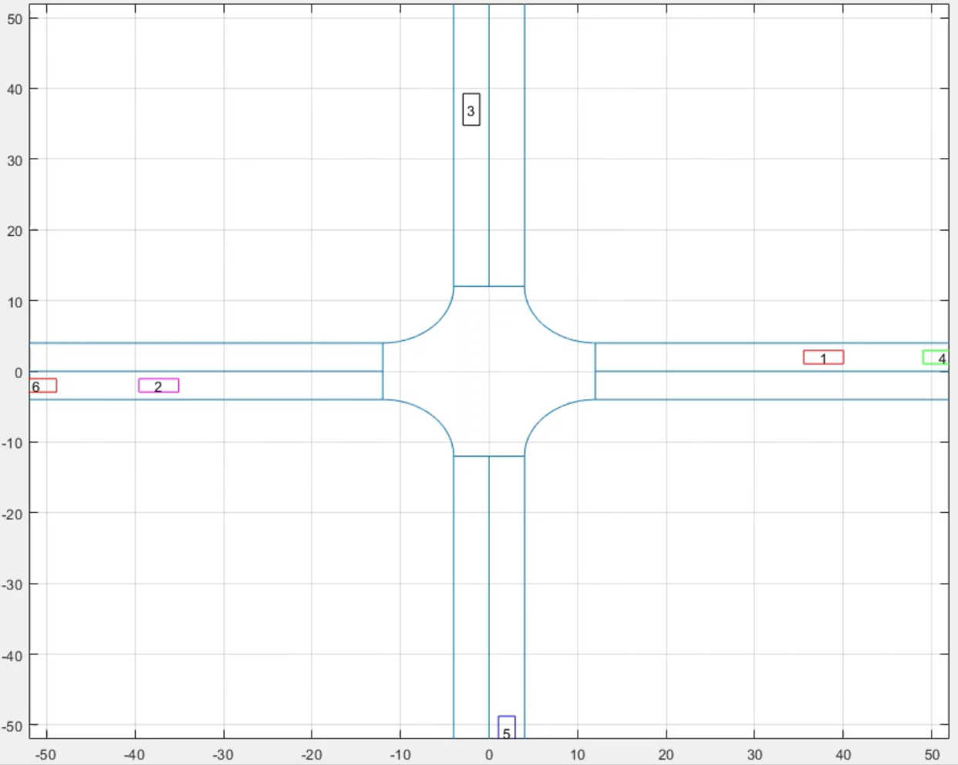
Analysis of the simulation results
Function validation via MiL-Simulations
Test case 2: Single intersection with irregular traffic volume in entry directions
Traffic intensity:
EW-Direction: 2880 vehicles/h
NS-Direction:
1440 vehicles/h
Traffic intensity:
EW-Direction: 5760 vehicles/h
NS-Direction:
2880 vehicles/h

