Slide 1
A Method for Estimating Blood Flow Condition from Skin Tone Information in Real Face Images
The University of Electro-Communications
Graduate School of Informatics and Engineering Department of Informatics
Itakura & Mizuno Lab.
Miku Shimizu
m.shimizu.0320@gmail.com
Notes:
Thank you Mr. chair person for my introduction.
I’m Miku Shimizu from the university of electro-communications,
In my presentation, I’m going to report on ~

Slide 2
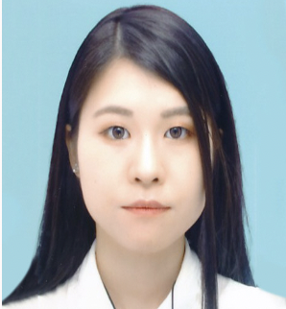
Education
Miku Shimizu
・Doctoral student 04/2023~
The University of Electro-Communications , Tokyo, Japan
Department of Informatics
・Master of Engineering 03/2023
The University of Electro-Communications , Tokyo, Japan
Department of Informatics
・Bachelor of Engineering 03/2021
The University of Electro-Communications , Tokyo, Japan
Management Science and Social Informatics Program

Slide 3
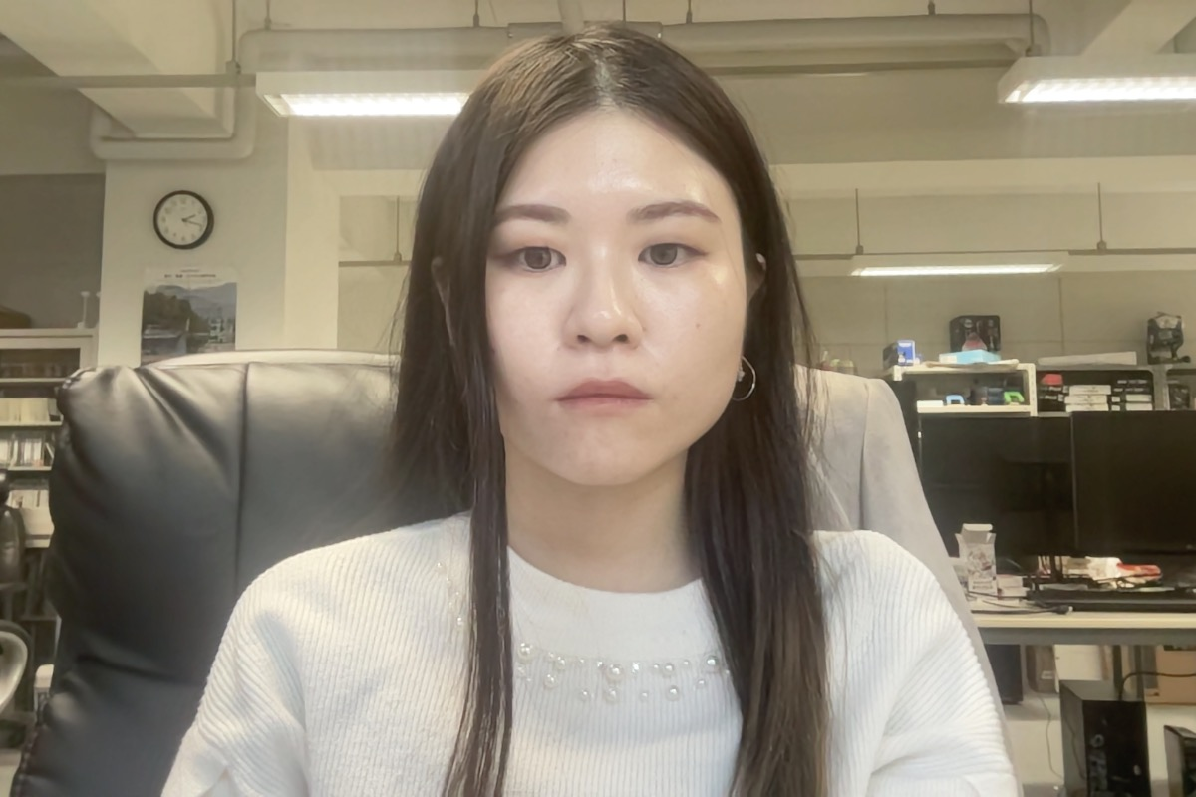
My laboratory topic
Itakura & Mizuno Lab
(The University of Electro-Communications)
Human computer interaction
…Creating systems that use biometric information
to make people more comfortable
My research expertise is Emotion estimation
People
User Interface
Computer
Real face image
Stress and emotion estimation

Slide 4
Background
Visualization of fatigue, stress → Quality of life ↑
Emotion and Stress Estimation Attention ↑
Previous study
Temperature changes associated with
nasal subcutaneous blood flow changes
Autonomic nervous activity
in peripheral blood vessels
Intermittent Mental Work Load
Nasal skin temperature
Infrared Thermography
→ High price & Difficult to use easily
(Previous study1：T. Mizuno, S. Nomura, A. Nozawa, H. Asano, H. Ide, “Evaluation of the Effect of Intermittent Mental Work Load by Nasal Skin Temperature”, IEICE Transactions on Information and Systems (Japanese edition), Vol. J93-d, No. 4, pp. 535-543, 2010. )
Notes:
In recent years, visualization of fatigue and stress has attracted increasing attention for its usefulness in improving quality of life, such as increasing efficiency in work and personal life.
As a method for measuring stress, previous studies have observed autonomic nervous activity derived from peripheral blood vessels, which can be an indicator of stress, by looking at temperature changes in the nasal region during continuity mental workload. This suggested the possibility of autonomic nervous activity estimation by focusing on nasal skin temperature. However, this method uses infrared thermography, which is expensive and difficult for anyone to use easily, making it impractical.

Slide 5
Background
Real face image → Autonomic nervous activity
Previous Study
White light
Evaluation of autonomic nervous activity
→ Subcutaneous blood flow changes
B Value
G Value
R Value
Epidermis
Penetration depth
Deepest ：R Value
Shallowest：B Value
Capillary
Dermis
Artery
Vein
Subcutaneous
tissue
R-B values
R-B values = Observe subcutaneous blood flow：Broadest
(Reference：Interface , 19, CQ Publisher, 2018/5．)
(Patent：Autonomic Nerve Activity Detection System, Autonomic nerve activity detection method and program , Miku Shimizu, Tota Mizuno, Naoaki Itakura Special application:2021-188255)
(Previous study1：Evaluation of methods for estimating autonomic nervous activity using a web camera , Miku Shimizu, Yu Matsumoto, Naoaki Itakura, Kazuyuki Mito, Tota Mizuno Artificial Life and Robotics 2022)

Slide 6
Background
Real face image → Autonomic nervous activity = Stress
Previous Study
White light
R-B values
= Autonomic nervous activity
evaluation index
B Value
G Value
R Value
Epidermis
Reflections and
shadows due to
unevenness
Capillary
Dermis
Artery
Vein
Nostrils
Subcutaneous
tissue
R-B values
≠ Changes in blood flow
Necessity of removal
(Reference：Interface , 19, CQ Publisher, 2018/5．)
(Patent：Autonomic Nerve Activity Detection System, Autonomic nerve activity detection method and program , Miku Shimizu, Tota Mizuno, Naoaki Itakura Special application:2021-188255)
(Previous study1：Evaluation of methods for estimating autonomic nervous activity using a web camera , Miku Shimizu, Yu Matsumoto, Naoaki Itakura, Kazuyuki Mito, Tota Mizuno Artificial Life and Robotics 2022)

Slide 7
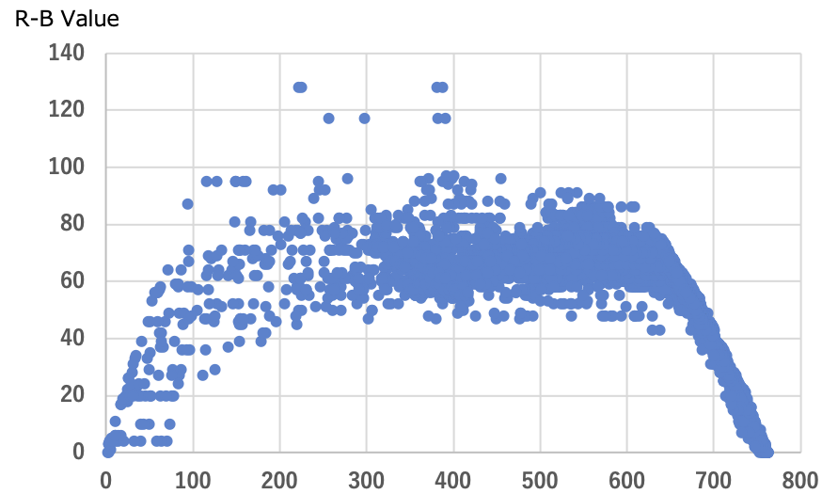
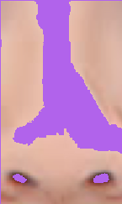
Proposed Method
Reflections and shadows
due to unevenness
Nostrils
Focus on the difference
in color from the skin
R+G+B Value
Black
Light intensity
White
R+G+B Value = Black(shadows)
White(reflections)
use
Narrowing the focus range
Slope is big
Possibility to identify a range where
the effect of light intensity is small
Characteristics distribution
Pixels corresponding to
the purple area were filled
Are all remaining pixels
blood flow changes?

Slide 8
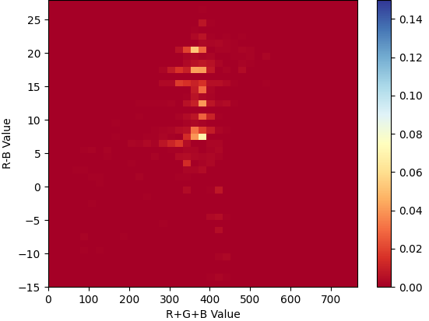
Proposed Method
Are all remaining pixels blood flow changes?
In this area,
Large changes in distribution
when blood flow changes occur
⇅
Pixels representing blood flow changes
R+G+B Value
Visual representation of
which areas have more pixels
Use heatmap
Before
After
Focus on
what changes
are occurring
Blood flow
changes

Slide 9
Experiment
Web camera
→ Real face image
Rest | Vascular compression experiment | Rest
20sec
20sec
20sec
Experimental motion
Vascular
compression
Rest
Ask the subjects
to lightly suppress the carotid artery
themselves

Slide 10
Result
Rest 20sec | Vascular compression experiment 20sec | Rest 20sec
Subject A
Subject B
Notes:
Thus, the proposed method makes it easier to see the correspondence between the distribution of pixels and the time-series changes in R-B values.

Slide 11
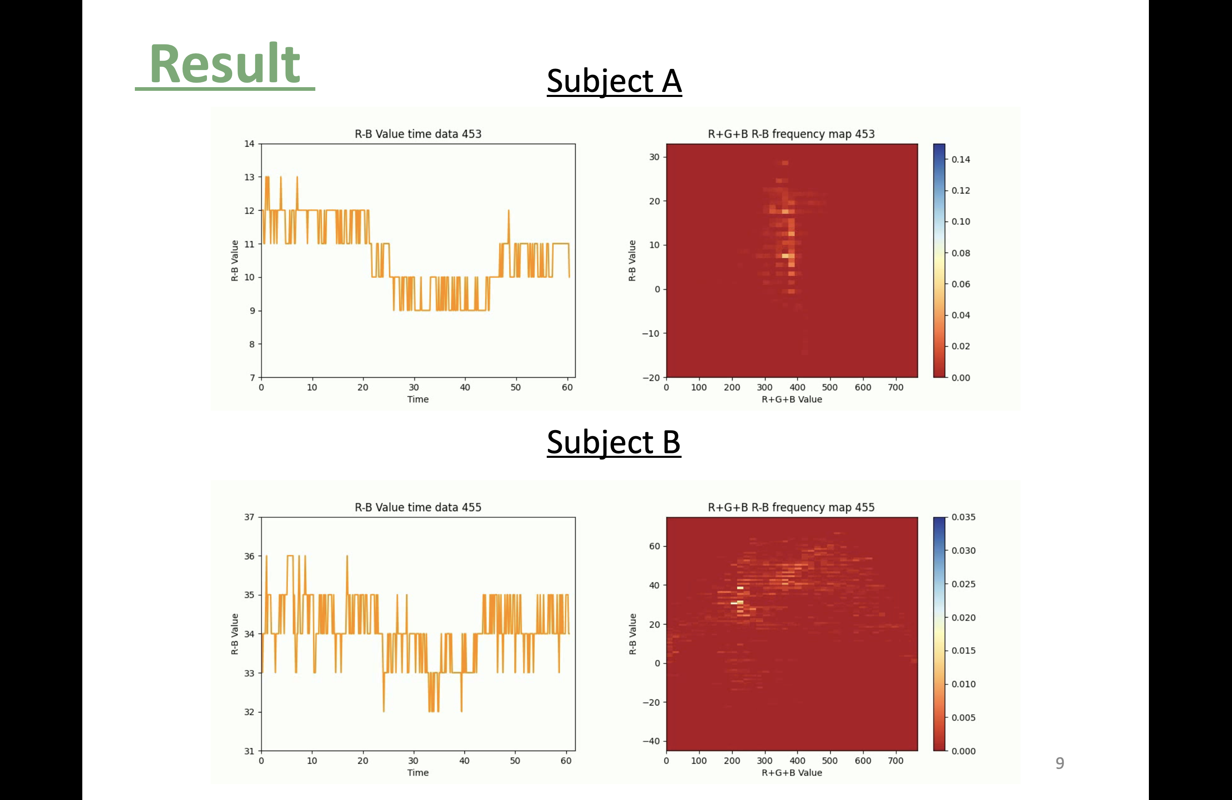
Result
Rest 20sec | Vascular compression experiment 20sec | Rest 20sec
Subject A
Vascular
compression
Compression
release
Both subjects
Vascular compression
→ R-B component value ↓
Compression release
→ R-B component value ↑
R-B component value
= Blood flow change
Compression
release
Vascular
compression
Subject B
Subject A
Vertically dense
Subject B
Scattering both vertically
and horizontally

Slide 12
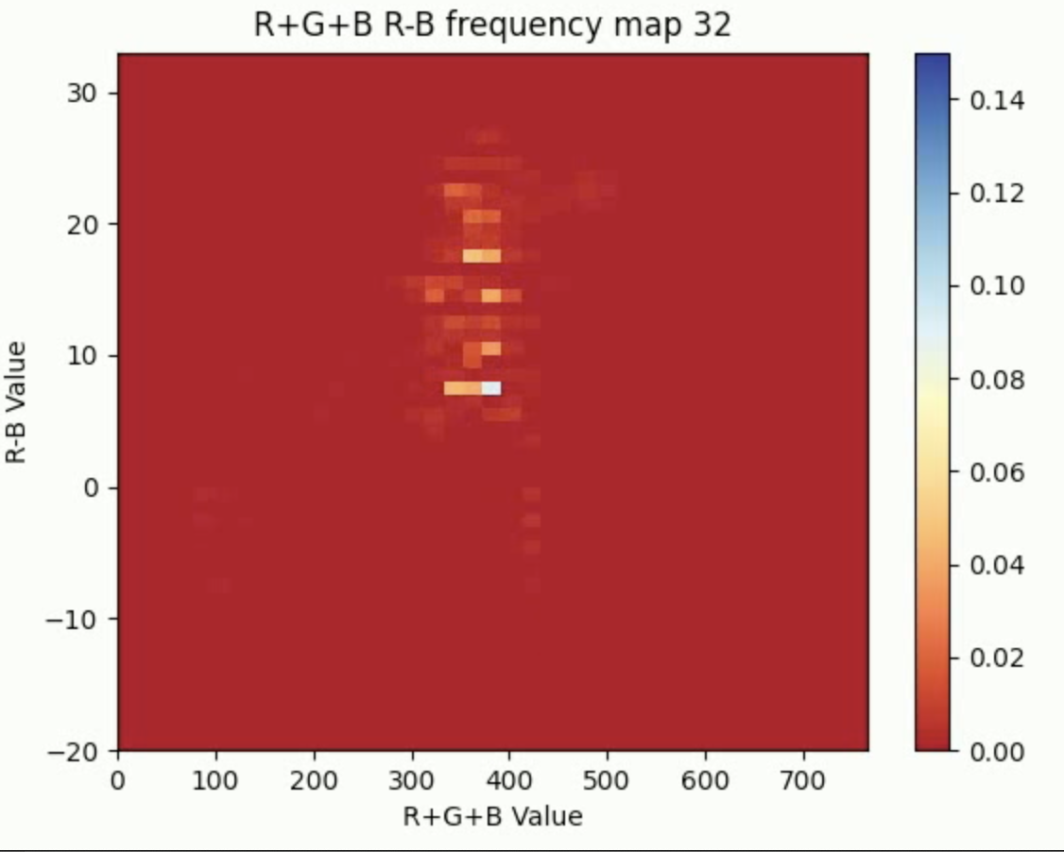
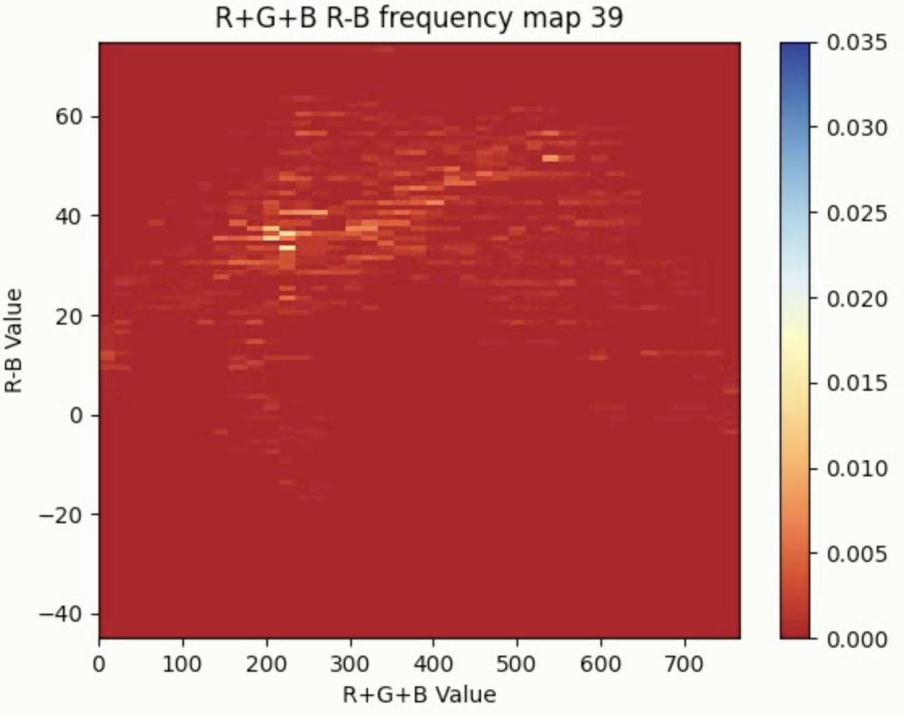
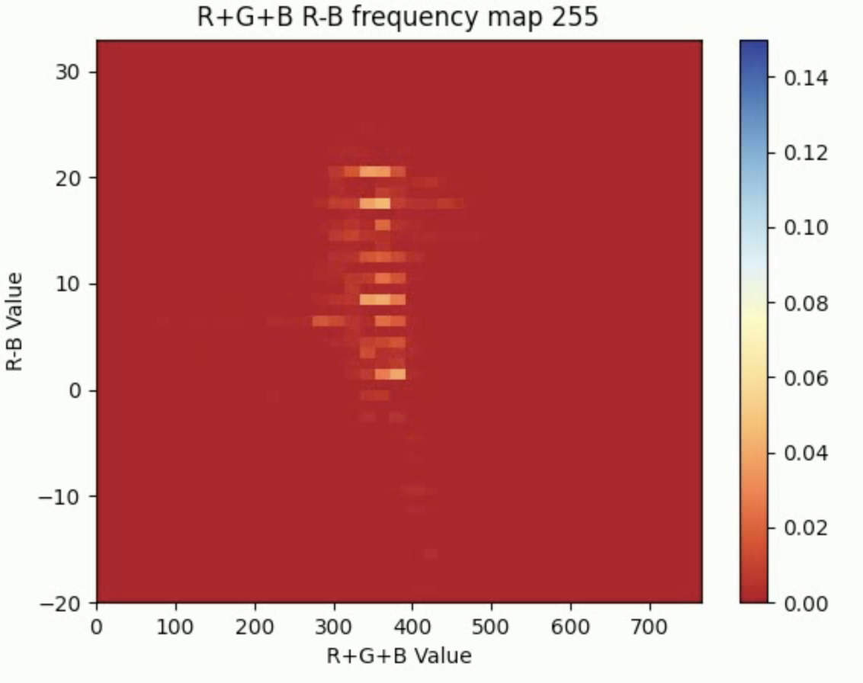
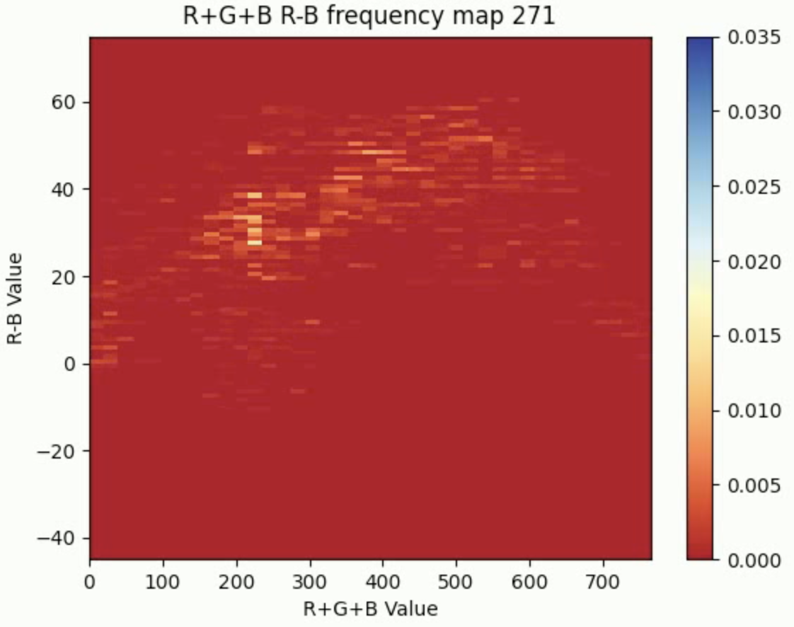
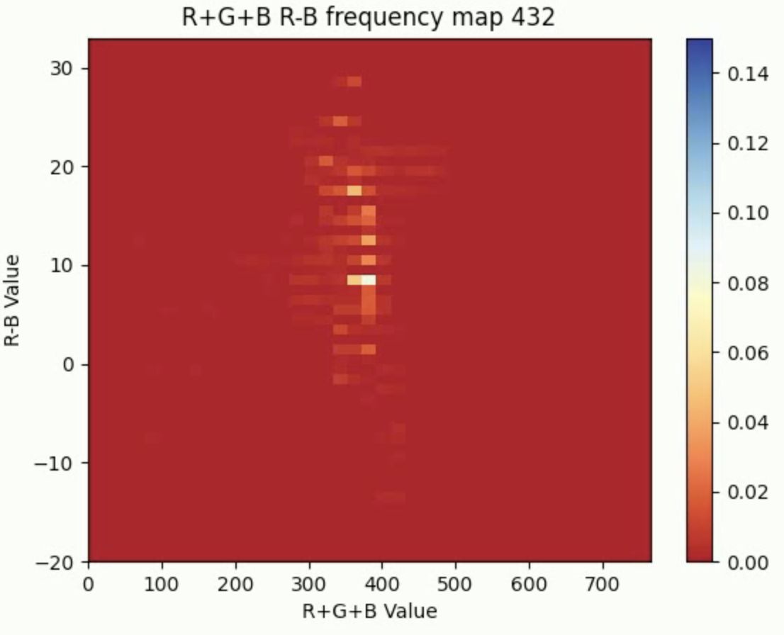
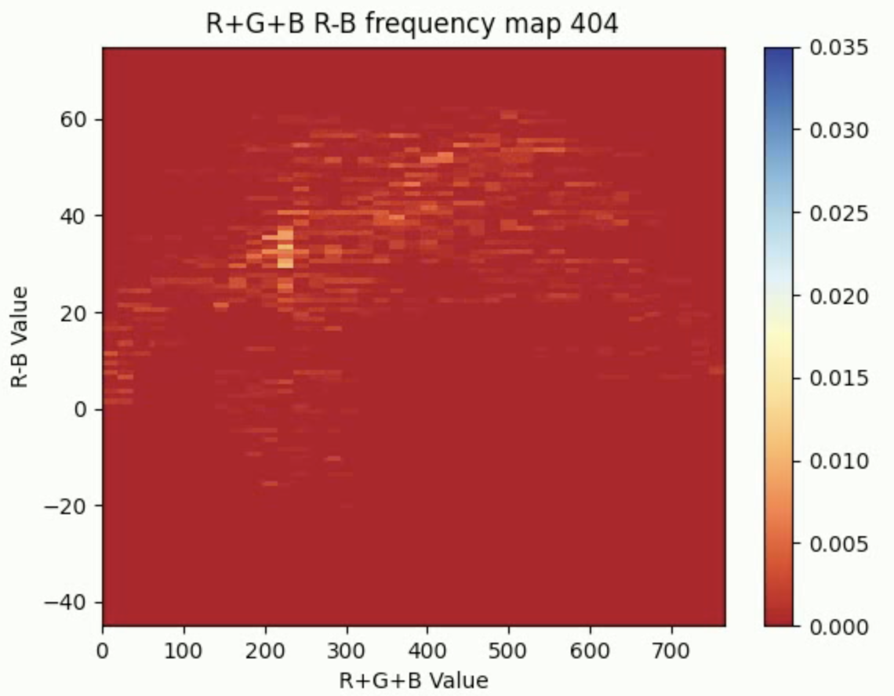
Discussion
：0 line of R-B Value
Subject A
Subject B
Vertically dense
Scattering both vertically and horizontally
①
①
③
②
②
①
③
①
②
②
Vascular compression(①②)
・R+G+B values unchanged
・Only the dense distribution
goes down
Distribution is spreading
↓
Vascular compression/release
⇅
Overall distribution variation occurs
No change in
distribution trend
③
③
Compression release(②③)
・R+G+B values unchanged
・Only the dense distribution
goes up

Slide 13
Summary
Propose：Devise a method to quantitatively remove the effect
of light intensity and acquire only blood flow changes
Method：Clarify the distribution and characteristics
of pixels corresponding to the nose
by creating heat maps
Result：Take a distribution with individual differences
among subjects
In the future：Seek ways to deal with the high impact
of individual differences
→ Consider variation in more detail

