Slide 1
CNN-Based Emotion Classification in Visual Art for Therapeutic and Creative Applications
Valentina Franzoni, Zofia Ruta
Department of mathematics and computer science university of Perugia, italy, valentina.franzoni@unipg.it
Faculty of Mathematics and Computer Science
Adam Mickiewicz University, Poznam, Poland

Slide 2
Emotion Recognition
From artworks
Enhance experience in art shows
Improve UX with synchronised lights, music, multimedia
Art therapy
Valentina Franzoni, ER in Visual Art
Notes:
Emotion detection in paintings has the potential to
enhance the experience of art exhibitions, where the emotions
conveyed by artworks can improve the viewer’s experience with
synchronized lighting, music, and multimedia elements. Also,
emotion recognition of visual art can be used in applications for
art therapy.

Slide 3
Convolutional Neural Networks (CNN)
CNNs + Transfer Learning
VGG16
InceptionV3
MobileNetV2
Prototype application
Valentina Franzoni, ER in Visual Art
Valentina Franzoni, Ethical AI
Notes:
This study presents a system that uses Convolutional
Neural Networks and Transfer Learning to detect emotions in
paintings, comparing VGG16, InceptionV3, and MobileNetV2,
three state-of-the-art models with different characteristics. A
prototype application has been thus developed to show the
classification capability of the best-performing model. The results
highlight the effectiveness of our approach, particularly for
binary classification, in real-world applications such as adaptive
art exhibitions and real-time art therapy tools.

Slide 4
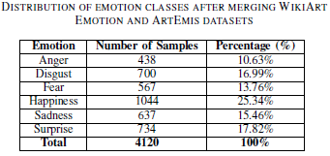
The relevance of data
WikiArt Emotion
+ =new dataset
ArtEmis
Valentina Franzoni, ER in Visual Art
Valentina Franzoni, Ethical AI
Notes:
Most of the papers in the state of the art, which are based on artistic datasets, present social and artistic photographs instead of paintings.
Challenges such as dataset limitations and the subjective nature of emotions in art were addressed through careful dataset integration and preprocessing, as well as the use of transfer learning to optimize performance.
In this work, by merging the WikiArt Emotion and ArtEmis datasets, we have created a more comprehensive and balanced dataset, improving the
data quality and allowing for more effective fine-tuning of deep learning models.
Our merged dataset labeled includes 4,120 images for emotion classification. The final distribution of the dataset across the six emotion classes of the Ekman model is shown in the Table.

Slide 5
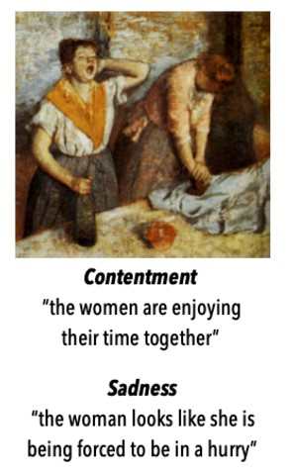
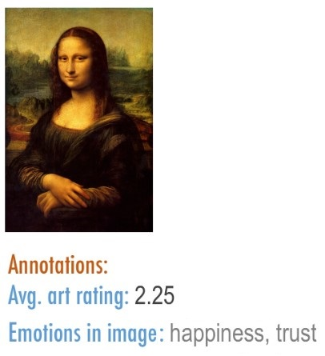
Examples of original data
WikiArt Emotion
ArtEmis
Valentina Franzoni, ER in Visual Art
Valentina Franzoni, Ethical AI
Notes:
The images show an example for ArtEmis, on the left-hand side, and of WikiArt Emotion, on the righ-hand side.

Slide 6
Training and optimization
Adam optimizer
Learning rate: 0.0001
Batch size: 32
Training for 50 epochs
Cross-entropy loss
80/20% data split for training/test
Accuracy, precision, recall, and F1
Valentina Franzoni, ER in Visual Art
Valentina Franzoni, Ethical AI
Notes:
The learning rate and the optimizer play critical roles in the
training and convergence of deep learning models. For this
study, the training was performed using the Adam optimizer
with a learning rate of 0.0001 and a batch size of 32.
The Adam optimizer was selected as the primary optimization
algorithm due to its proven effectiveness in handling
sparse gradients and dynamically adapting learning rates
during training. This adaptability is particularly useful for
complex tasks such as emotion recognition in visual art, where
the gradient landscape can be highly non-linear and difficult
to navigate. The models were trained for 50 epochs, and early stopping
was implemented to avoid overfitting. Cross-entropy loss was
used as the loss function for both binary and multiclass
classifications. An 80/20 train-test split was applied to the dataset. Function parameters in Python has been adapted to
classify on unbalanced classes.
Performance metrics such as accuracy, precision, recall, and
F1 score were tracked during training. Such settings have been
tested and chosen experimentally.

Slide 7
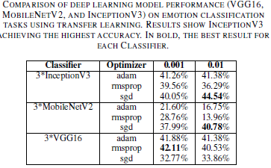
Results (multiclass)
InceptionV3 outperformed other classifiers.
Valentina Franzoni, ER in Visual Art
Valentina Franzoni, Ethical AI
Notes:
The model, fine-tuned on the merged datasets showed promising results, especially with the InceptionV3 model, which outperformed the other classifiers. A comparison of performance for the CNNs is shown in the table. The best accuracy achieved by VGG16 was 42.11% when trained with the RMSprop optimizer at a low learning rate. Although it performed well
compared to MobileNetV2, its precision, recall, and F1 score were lower than those of InceptionV3, especially in distinguishing emotions such as anger and sadness. The highest accuracy recorded for MobileNetV2 was 43.2% when using the Adam optimizer with a low learning rate. However, its precision
and recall were not as consistent, and it generally underperformed. InceptionV3 also showed the best balance of precision, recall, and F1 score, especially for emotions such as happiness, surprise, and fear. While it struggled slightly with anger and sadness, it still outperformed the
other models in these categories.

Slide 8
Results (binary)
InceptionV3 outperformed other classifiers.
Unpleasant=anger, disgust, sadness, fear (2342 samples); Pleasant=happiness, surprise (1778 samples)
Valentina Franzoni, ER in Visual Art
Valentina Franzoni, Ethical AI
Notes:
The binary classification task highlights the feasibility of emotion detection in visual art when the emotional states are
grouped into categories for pleasant and unpleasant emotions.
The highest accuracy for binary classification was achieved using the InceptionV3 model with an accuracy of 71%. This result was measured consistently across the test set, demonstrating reliable classification of pleasant and unpleasant emotions.
All three metrics (Precision, Recall, and F1-score) were recorded at 71%, indicating balanced performance.
The highest multiclass accuracy achieved was around 45%, with the InceptionV3 model outperforming both VGG16 and MobileNetV2. The confusion matrix for the multiclass classification showed that the model was more accurate at recognizing emotions such as surprise, happiness, and fear, but struggled with emotions such as anger and sadness. The overlap between these emotions suggests that they share similar visual cues, making them harder to distinguish. Although the dataset was more balanced after merging datasets, there was still a slight skew, with emotions like happiness and surprise slightly more represented than others like anger and fear.
The confusion matrix for binary classification, in the figure, showed that most misclassifications occurred between
emotions that were borderline or ambiguous.

Slide 9
Conclusions
CNNs can be effective for ER in visual art
Combining multiple datasets is beneficial
Binary classification has better performance
InceptionV3 performs reasonably well
Future improvements
Diverse data for complex emotions
Data augmentation to improve generalization
Multimodal (visual + textual) models
Valentina Franzoni, Ethical AI
Notes:
This study demonstrates the effectiveness of convolutional neural networks (CNNs) for emotion recognition in visual art, specifically applying VGG16, MobileNetV2, and InceptionV3 models fine-tuned using a combination of the WikiArt
Emotion and ArtEmis datasets, particularly for binary classification (pleasant/unpleasant emotions), with balanced performance across metrics. Although multiclass classification yielded lower accuracy due to the nuanced and subjective nature of emotions in art, InceptionV3 still performed reasonably well, especially in recognizing emotions such as happiness, surprise, and fear.
The approach presented here highlights the potential of using deep learning models for applications in art therapy and
immersive art experiences. Our results highlight the benefits of combining multiple datasets to improve emotion detection in art.
Future work could explore the inclusion of more diverse datasets and further refine the classification capabilities, especially for complex emotions.
Targeted data augmentation strategies (such as brightness adjustments, hue shifts) could help simulate the variability in emotion expression and improve model generalization.
Regarding the classification model, combining visual features with textual descriptions (e.g., artist statements or
viewer annotations) could provide complementary information to improve emotion classification. Addressing these challenges
will involve refining dataset quality, exploring multimodal methods, and incorporating advanced architectures.

Slide 10
Contacts
For informations or Q&A, write to valentina.franzoni@unipg.it
Find us on Facebook @affectivecomputing www.facebook.com/affectivecomputing

